Slide 1
Wayside Shrine Images

Slide 2
Three kinds of historical wayside shrines:
Pillar shrines
“Serving Spoon” Shrines
Chapel Shrines

Slide 3
Schoenstatt Wayside Shrines have generally been “chapel shrines,” which have a pointed roof over the image of the Mother Thrice Admirable. In their design, they point symbolically to the Original Schoenstatt Shrine in Germany and to replica (“daughter”) Schoenstatt Shrines.

Slide 4
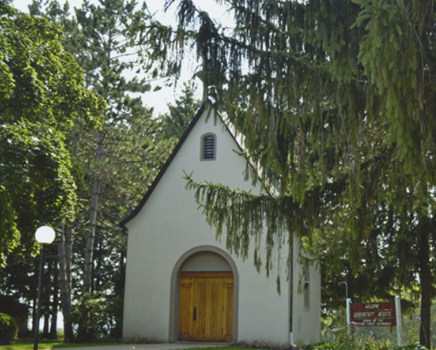

Slide 5
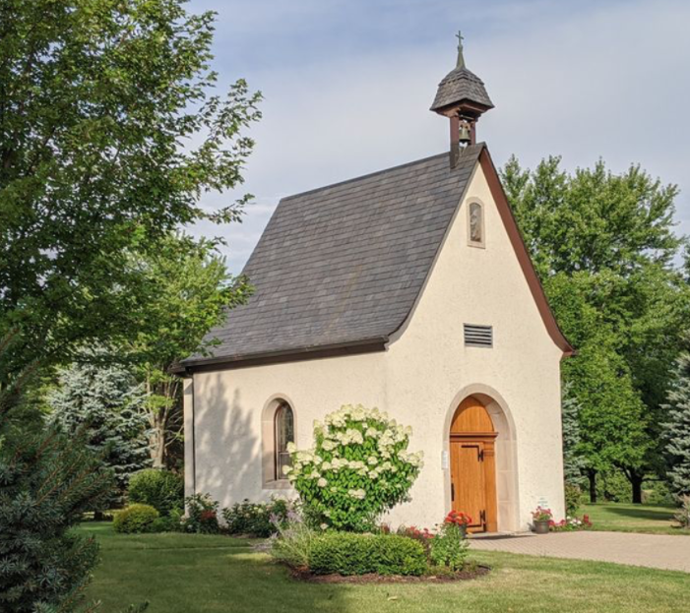

Slide 6
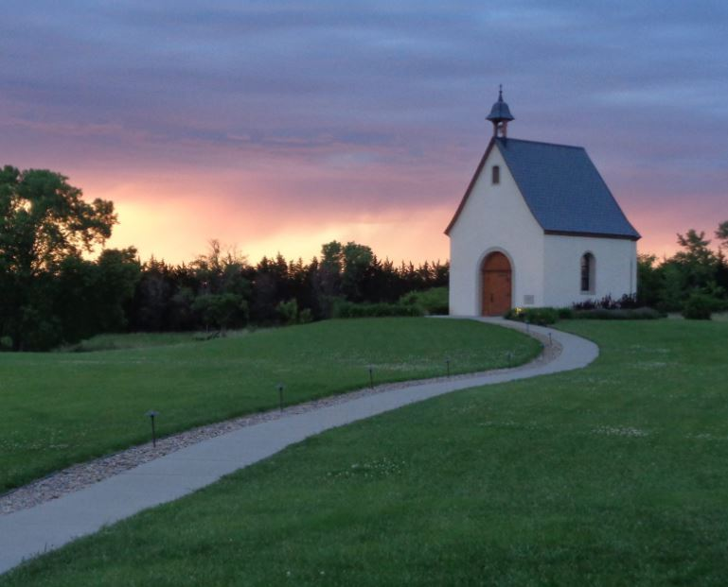

Slide 7
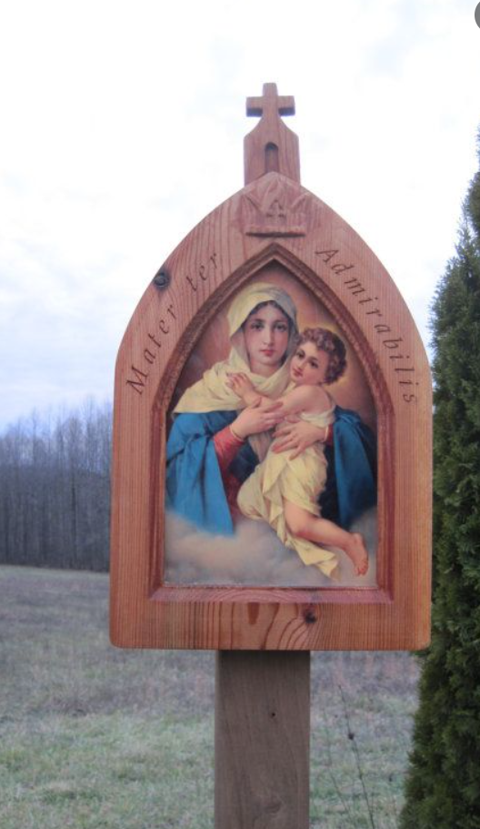
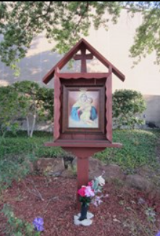
Small wayside Schoenstatt Shrines are often made of wood and mounted on a wooden pole. Their outline recalls that of the full-scale Shrine, with its pointed roof, bell-tower, and cross.

Slide 8
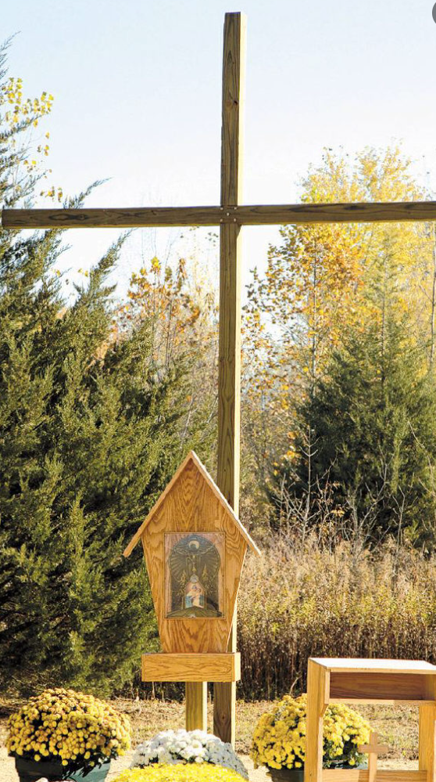
Our current “Mother of the Eucharist” Schoenstatt Wayside Shrine is a “chapel shrine” by its outline (peaked roof), which invokes the full-scale Schoenstatt Shrine. It includes a small MTA picture inserted in an artwork with the Unity Cross. A tall wooden cross stands behind the Wayside Shrine. It is beautiful, but we agree that the MTA picture is too small, and that the Shrine needs renovation.

Slide 9
The large mosaic MTA picture (30 X 40 inch) we now have requires a stronger support, a cement (or cement block) wall. Like the smaller, wooden wayside shrines, the envisioned Wayside Shrine in Delphi should remind people of the full-scale Schoenstatt Shrine, but without substituting for it. It should INCREASE the longing of people for the building of a replica Shrine, both by its similarity and by its difference.

Slide 10
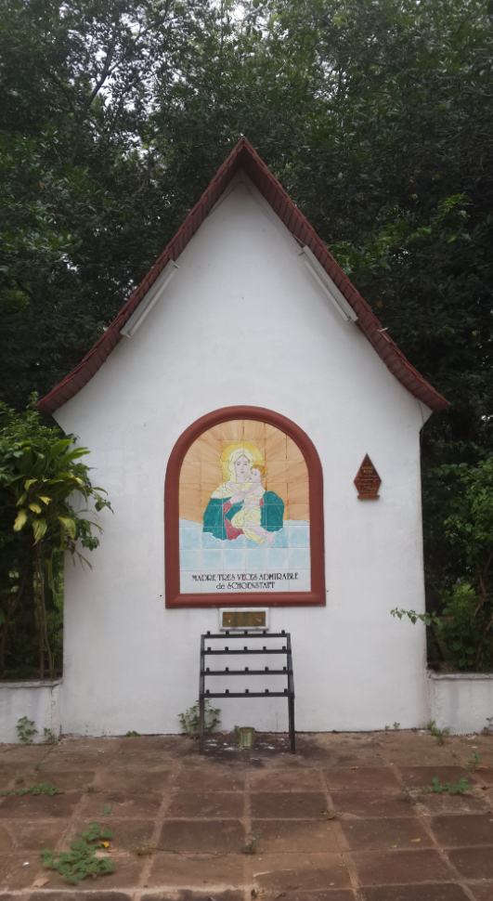

Slide 11
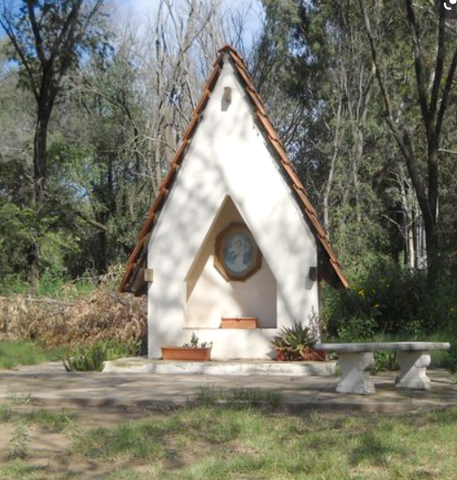

Slide 12
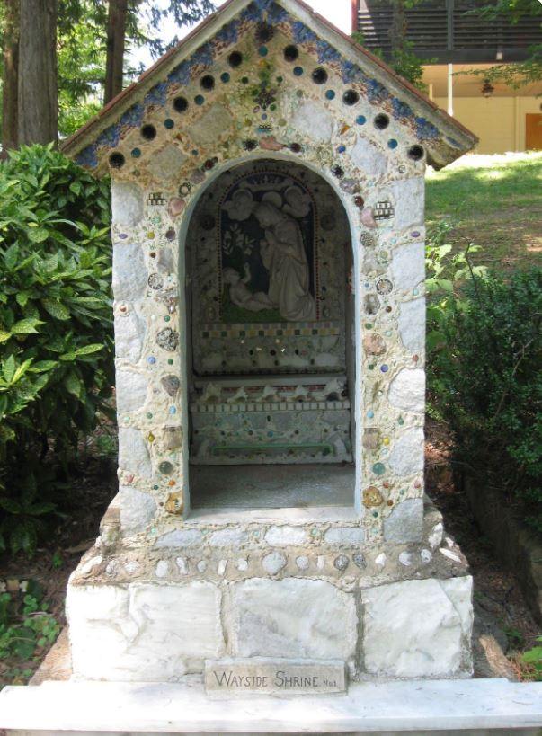

Slide 13
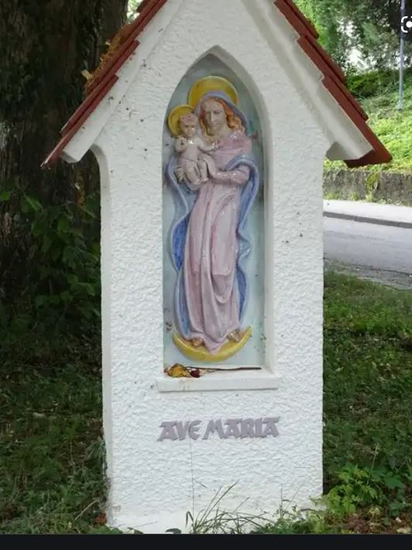

Slide 14
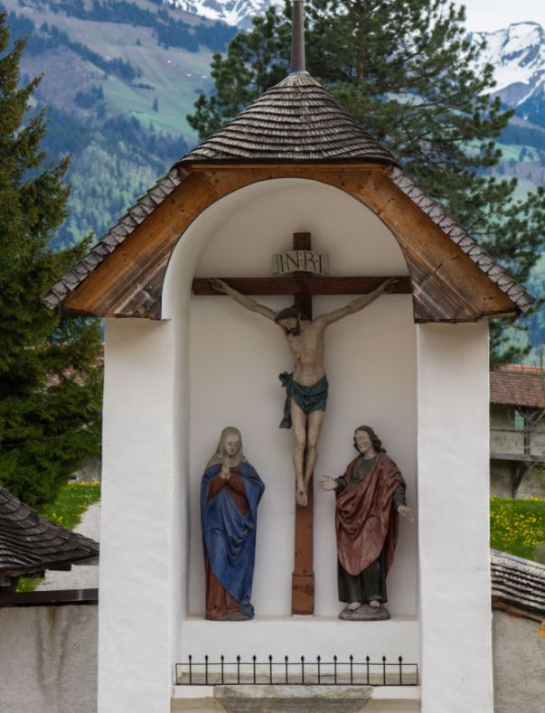

Slide 15
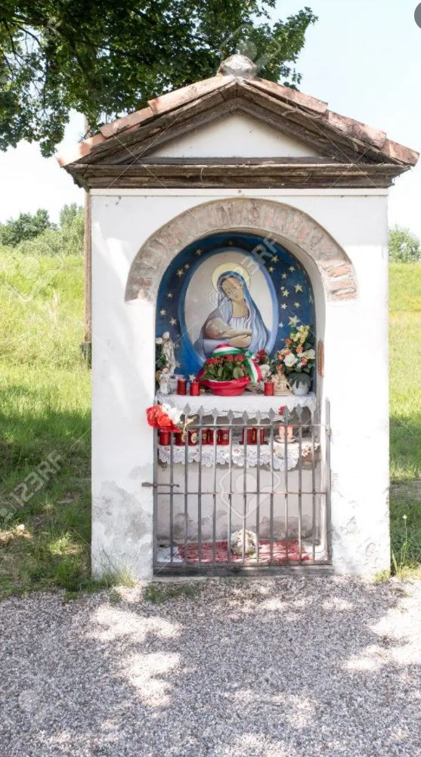

Slide 16
