Slide 1
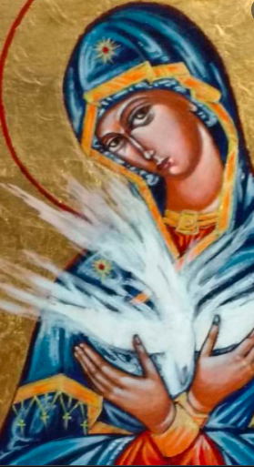
Come, Holy Spirit, through our Covenant of Love with Mary!
January 15, 2022

Slide 2
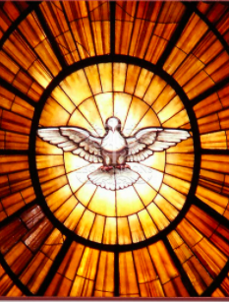
The Holy Spirit is the Sanctifier. To the Holy Spirit is attributed the work of dispensing the seven-fold gifts of grace, the graces of conversion and transformation.

Slide 3
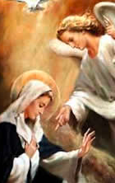
Mary, our Mother Thrice Admirable, is the “Mediatrix of grace” because of her special relationship to the Persons of the Triune God. Through her Immaculate Conception, Christ made her “full of grace.” The Holy Spirit overshadowed her at her own immaculate conception and at the hour of the Annunciation, when the Virgin conceived the Word-made-flesh.

Slide 4
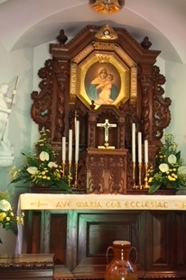
Through the working of the Holy Spirit, Schoenstatt is also a channel of grace for the Church and world through the pilgrimage graces that our Lady, the Mediatrix of all graces, distributes from her throne of grace in the Shrine.
In this sense, Schoenstatt is a charismatic movement of renewal within the Church.

Slide 5
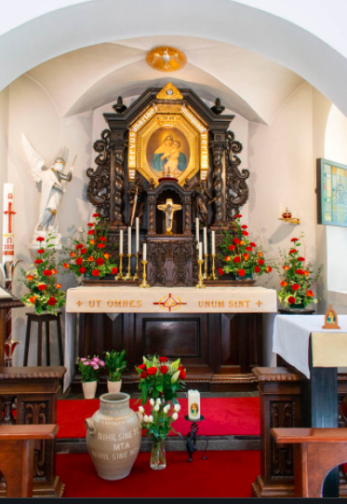
The Holy Spirit continuously overshadows the Blessed Mother in the Shrine. The “shadow of the Shrine” about which Father Kentenich spoke is ultimately this overshadowing of Mary by the Holy Spirit. . . .an “overshadowing” that also overshadows us in the Shrine!

Slide 6
In Spirit I kneel before your picture,
Thrice Admirable, strong and gentle Mother,
United with all who have consecrated themselves to you
And are ready to die for your realm.
(Introductory prayer, Schoenstatt Office)
We kneel in the Holy Spirit
And sing jubilant hymns to Christ,
Who sends us with her as instruments
To change the destiny of nations.
(Heavenwards, Morning Prayer)

Slide 7
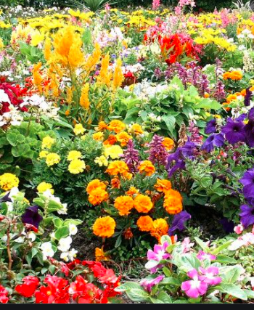
The Holy Spirit finds and forms Mary in us, because in our Covenant of Love with her we are united with her. We have consecrated our “entire self without reserve” to her. We belong to her and live as “little Marys” in close union with her. In the Mariengarten, “little Marys” bloom!

Slide 8
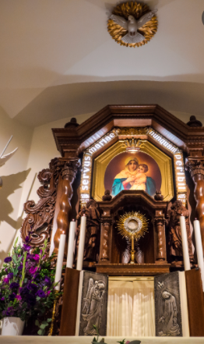
I believe . . . in Jesus Christ, His only Son, Who was conceived of the Holy Spirit, born of the Virgin Mary, suffered under Pontius Pilate, was crucified, died, and was buried; He descended into hell; on the third day he rose again from the dead; He ascended into Heaven and sits at the right hand of God the Father Almighty . . . I believe in the Holy Spirit, the holy catholic Church, the communion of saints . . .

Slide 9
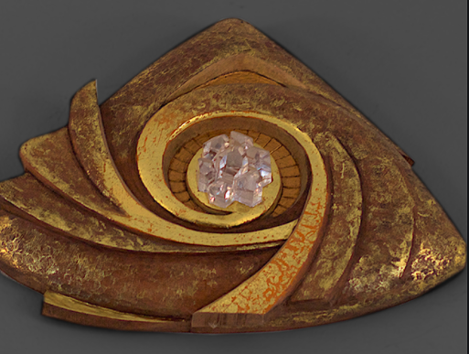
What do the three pilgrimage graces have to do with the Covenant of Love, which binds us to Mary as the spouse of the Holy Spirit?

Slide 10
We often speak of the Covenant of Love as the exchange of hearts, goods, and interests with the Blessed Mother.
These correspond to the three pilgrimage graces!!
Exchange of Hearts = Grace of Home
Exchange of Goods = Grace of Transformation
Exchange of Interests = Grace of Apostolic Zeal and Fruitfulness

Slide 11
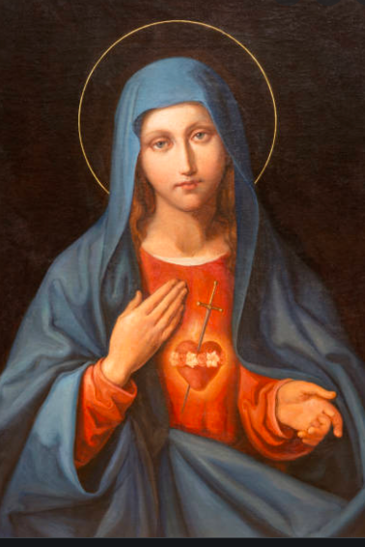
Father Franz Bezler in Schoenstatt, a University of Trust, gives a slightly different expression to the meaning of the Covenant of Love when he says that it includes three elements:
The Devotion of Love (Hearts)
The Surrender of Love (Goods)
The Giving on of Love (Interests)

Slide 12
The “Devotion of Love”: In the Covenant of Love, I know to whom I give myself. My Covenant partner is a real person. I recognize her, and she knows me. I call her name, and she calls mine. She calls mine, and I reply, “My Queen, my Mother.”
I am “at home” in this loving relationship, in this bond of hearts, and the Shrine symbolizes this home. Being spiritually and physically in the Shrine also brings me again and again into the presence of the one I love.
“My Queen, my Mother . . .”

Slide 13
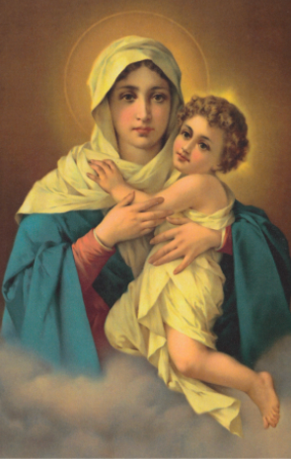
In Spirit I kneel before your picture,
Thrice Admirable, strong
and gentle Mother,
United with all who have consecrated themselves to you
And are ready to die for your realm.
(Introductory prayer, Schoenstatt Office)

Slide 14
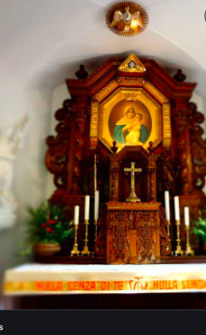
Devotion of Love, Grace of Home:
We are united in the Shrine
Where the flames of our hearts
Beat for our Mother Thrice Admirable,
Who, through us, wants to build your realm. (Heavenwards, Morning Consecration)

Slide 15
Surrender of Love (Exchange of Goods), Grace of Transformation
“I give myself entirely to you, and to show my devotion to you, I consecrate to you this day my eyes, my ears, my mouth, my heart, my entire self without reserve.”
A person who has given away her eyes . . . is blind.
A person who has given away her ears . . . is deaf.
A person who has given away her mouth . . .is dumb, unable to speak.
A person who has given away her heart . . .
Total sacrifice . . .
THEREFORE, Mary gives us her eyes, her ears, her mouth, her heart, her entire self without reserve . . .

Slide 16
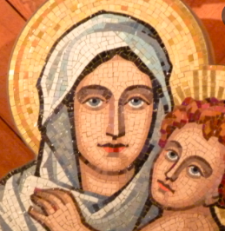
The goal of the Covenant of Love is our perfect transformation into another Mary! Mary should see through us the needs of others. Mary in us should hear God’s call, God’s wish and will. Mary in us should speak words of wisdom and love. Mary in us should love God and others.
This is the fruit of the lived
Blank Check and
Inscriptio cordis in cor.

Slide 17
How does the lived Blank Check bring about our transformation?
Saying “yes” to God’s call helps me to live in God’s presence.
I willingly accept whatever suffering is in God’s wise, loving, mighty plan for me.
I gladly do what God calls me to do.
Action and suffering! A Blank Check surrender means my trustful “yes” to the Mother of God, who calls to me through the circumstances of everyday life and though the inner voice of my conscience. I am attuned to her. Practical Faith in Divine Providence helps me to know what to endure, what to do and dare. The Holy Spirit gives me a divine instinct to sense God’s presence, God’s wish and will. Mary lives in me, works in me!

Slide 18
A Blank Check means a pure heart on which the MTA may “write” any request. Everything becomes TRANSPARENT to God’s love, so that “nothing can separate us from the love of Christ”! (See Romans 8: 31-39)
The Holy Spirit works this transformation in our heart-shrines.

Slide 19
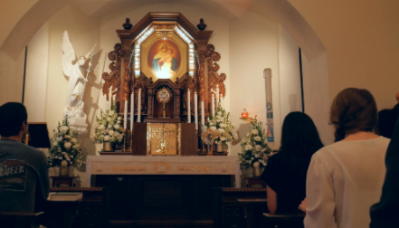
Grace of transformation! Surrender of love in the Covenant of Love!

Slide 20
Giving on of Love (Exchange of interests), Grace of Apostolic Zeal
As I am your own, my good Mother, guard me and defend me [and use me] and your property and possession.
Fr. Bezler speaks of apostolic deeds in connection with the “giving on” of love in the Covenant of Love.

Slide 21
In Schoenstatt’s history, the MTA’s distribution of the pilgrimage graces from the Shrine led to the unfolding of Schoenstatt’s threefold spirituality:
Home . . . in Covenant Spirituality
Transformation . . . in Everyday Sanctity
Apostolic Zeal . . . in Instrument Piety
Everyday Sanctity and Instrument Piety are really aspects of Covenant Spirituality. All the graces stem from the original Covenant of Love.

Slide 22
The Covenant of Love with the Mother Thrice Admirable, Queen, and Victress of Schoenstatt renews our Baptismal Covenant, our dying and rising in Christ, our profession of faith, our Baptismal promises, our “new life” in Christ. The font of our Baptism makes Mary our Mother in Christ. We are born anew! The Holy Spirit descends upon the waters of Baptism to sanctify them, to make us “a new creation” in Christ.

Slide 23
Do we find the work of the Holy Spirit in each of the three pilgrimage graces? Do we find the sanctifying activity of the Holy Spirit in every dimension of Schoenstatt’s spirituality?

Slide 24
Scriptural images of the Holy Spirit’s
presence, descent, activity:
At Nazareth:
“And the angel answered her,
‘The Holy Spirit will come upon you,
and the power of the Most High will overshadow you;
therefore the child to be born
will be called holy—the Son of God.’” (Luke 1:35)

Slide 25
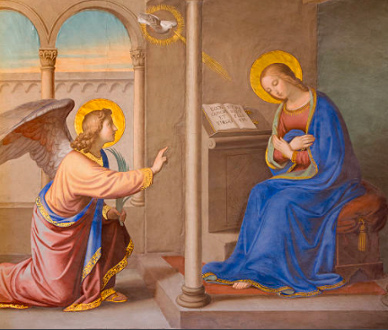
“Your Shrine is our Nazareth”: Grace of Home.
There Gabriel speaks God’s request,
And your Fiat illumines the world. . . . . .
Like you, let me always be faithful to the Blank Check.
(Heavenwards)

Slide 26
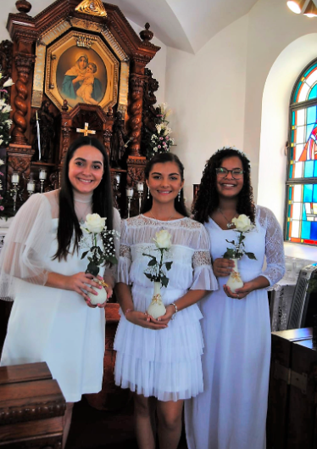
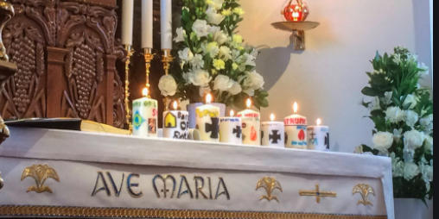
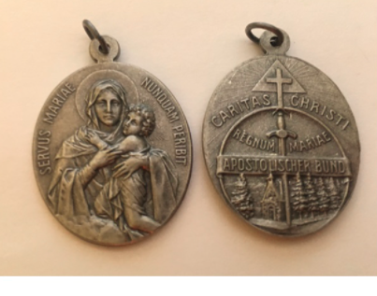

Slide 27
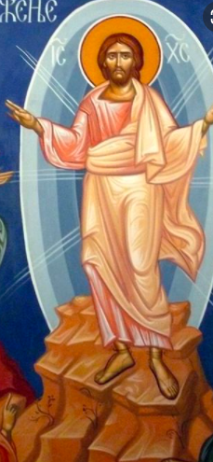
The Shrine, our Tabor! Grace of Transformation! (Surrender of Love)
And He was transfigured before them; and His face shone like the sun, and His garments became as white as light. (Matthew 17:2)

Slide 28
7 When St. Peter saw the glory of God on Tabor, he called out with delight, "It is good for us to be here. Let us build three tents here" (Mt 17,4). These words come to my mind again and again. And I have often asked myself: Would it not be possible for our little sodality chapel to likewise become for us the Tabor on which the glory of Mary would be revealed? Undoubtedly, we could not accomplish a greater apostolic deed nor leave our successors a more precious legacy than to urge our Lady and Queen to erect her throne here in a special way, to distribute her treasures, and to work miracles of grace. You gather what I am aiming at: I would like to make this place a place of pilgrimage, a place of grace for our house and for the whole German province, and perhaps even further afield. All those who come here to pray shall experience the glory of Mary and confess: "It is good for us to be here. Here we will build our tents, here our favorite place." A bold thought, nearly too bold for the public, but not too bold for you. How often in world history have not small and insignificant beginnings been the source of great and greatest accomplishments? (First Founding Document, Oct. 18, 1914)

Slide 29
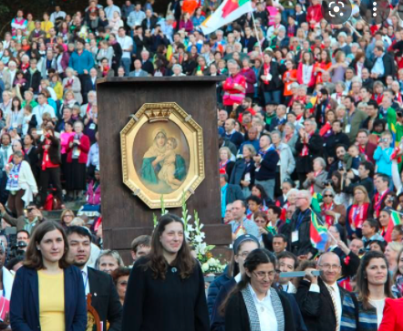

Slide 30
Our Shrine, the Tabor of Mary’s Glories: Grace of Transformation
“Your Shrine radiates into our times
The brilliance and splendor of Tabor’s sun. . . .
It is good to be there, as in Paradise,
Because it is the Holy Spirit’s dwelling. . . .
You work in Schoenstatt as Mediatrix
And mercifully lead us to the Holy Spirit. . . .
Let us be deeply penetrated by Christ’s Spirit
And richly bless us with eloquent tongues of love.” (Heavenwards)

Slide 31
Our Shrine, our Cenacle! Grace of Apostolic Zeal and Fruitfulness
(Giving on of Love!)
When they entered the city they went to the upper room where they were staying, Peter and John and James and Andrew, Philip and Thomas, Bartholomew and Matthew, James, son of Alpheus, Simon the Zealot, and Judas son of James. All these devoted themselves with one accord to prayer, together with some women, and Mary the Mother of Jesus and his brothers. . . . And suddenly a noise like a violent rushing wind came from heaven, and it filled the whole house where they were sitting. They saw tongues like flames of fire that separated and came to rest on each of them. (Acts 1:13-14; 2:2-3).

Slide 32
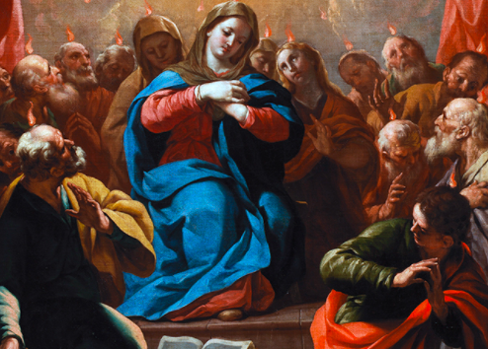

Slide 33
Our Shrine, our Cenacle! (Vespers in the Schoenstatt Office)
The sun makes ready for the night
And invites us to enter the Cenacle.
There you implored the Spirit for the Church
Who freed her from the scourge of half-heartedness,
Guided her to the teaching of Christ,
And enkindled in her the spirit of the apostles and the martyrs. (cont.)

Slide 34
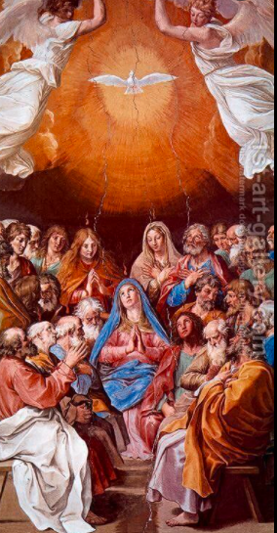
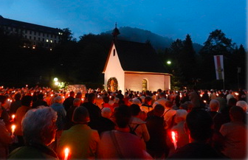
That is how you want to work in our Shrine,
Strengthening our weak eyes of faith
So that we might always see life as God sees it
And always walk by Heaven’s light. (Heavenwards)

Slide 35
“You will accompany me, Lord, wherever you send me in the whole wide world: whether I go to the pagans or stay in the midst of believers. You will give me light and strength to counter evil passions. You will form me after your image as we see it in your Bride. You will constantly prepare my heart for the Spirit of Holiness, who fills me with magnanimity and graciously satisfies my longing. If I so remain with you, you will gradually transform me, and the Father will look on me from eternity with great delight.” (Heavenwards, Prayer after Holy Communion, Mass of God’s Instruments)

